Slide 1
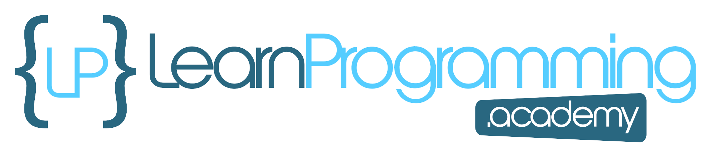
What Is Networking?
Networking is the foundation of modern communications.
A network is a system of computers and other devices connected together, so that they communicate with each other, to exchange data and share resources.
Networking refers to how the connected computers communicate.
This can be done over the internet, or over a local area network, which is just a collection of devices, connected together in one physical location.
COMPLETE JAVA MASTERCLASS
Networking Terminology

Slide 2
Why is networking important in software development?
Important reasons for networking:
Data Communication, allowing applications to exchange data in real-time, between users and systems.
Distributed Systems, allowing applications to be deployed across many servers.
Foundational for Internet and Cloud Computing.
Enables Remote Access, and Control, to distributed systems.
Enables communication between applications, through the use of APIs and Web Services.
COMPLETE JAVA MASTERCLASS
Networking Terminology

Slide 3
Private Network (Intranet)
Computers may also communicate across a private network, also known as an intranet.
In fact, that's where networking actually began, and intranets are still common today in business.
COMPLETE JAVA MASTERCLASS
Networking Terminology

Slide 4
The Host
A host refers to any hardware device capable of participating in network communication.
A common networking configuration that you've probably heard of is client server.
This means that one or more hosts on the network are acting as servers, and the other hosts are clients that connect to the server.
COMPLETE JAVA MASTERCLASS
Networking Terminology

Slide 5
What's a client?
Clients are end-user devices or applications, that request services or resources from servers.
They initiate communication with the servers, and rely on them, to fulfill specific requests.
COMPLETE JAVA MASTERCLASS
Networking Terminology

Slide 6
What's a server?
Servers are usually powerful computers or software applications, that provide services or resources to clients.
They listen for incoming requests from clients, process those requests, and respond with the appropriate data or action.
COMPLETE JAVA MASTERCLASS
Networking Terminology

Slide 7
What's a client-server model?
Communication between the user's devices, and servers responding to their requests, is called the client-server model.
This is a very common networking model, used in many different applications, including web applications, email, file sharing and gaming.
Web browsing is a classic example, where the web browser (the client) sends requests to web servers, and the servers respond by sending back web pages, images, or other resources.
COMPLETE JAVA MASTERCLASS
Networking Terminology

Slide 8
Client-server applications can run on a single host
As I mentioned, you can have a client server interaction on the same host.
For example, the MySQL database comes with software we've been using called MySQL Workbench.
The workbench is the client, and it connects to the MySQL database server on that local host.
It could also connect remotely to another server if needed as well.
COMPLETE JAVA MASTERCLASS
Networking Terminology

Slide 9
How do the client and server communicate?
Clients and Servers communicate through several layers of protocols.
The lowest level is the network layer, which uses addresses to facilitate network communication.
On top of this, is the data transport layer.
COMPLETE JAVA MASTERCLASS
Networking Terminology

Slide 10
The Port
When data arrives at the one physical connection to the network, it gets routed to the target application through a port.
Each application that needs data from the network is assigned a port.
This includes clients connecting to a server, that's on the same machine.
When data arrives, the port number is used to route the data, for the specific application that's waiting for it.
A port number is a positive integer between 0 and 65535.
COMPLETE JAVA MASTERCLASS
Networking Terminology

Slide 11
The IP Address
Every host connected to the Internet also has a unique IP address, including yours.
IP stands for Internet Protocol.
This describes the destination, or where the data is supposed to go in the network, and it does it with an IP address.
COMPLETE JAVA MASTERCLASS
Networking Terminology

Slide 12
IPv4 vs. IPv6
IPv4 stands for Internet Protocol Version 4, and IPv6 stands for Internet Protocol Version 6.
Once upon a time, there were only IPv4 addresses.
IPv4 uses a 32-bit address scheme, that allows for over 4 billion unique addresses.
Now that we've got computers, tablets, game consoles, smart TVs, smartphones, smart appliances, four billion IP addresses wasn't really enough, and so IPv6 was born.
COMPLETE JAVA MASTERCLASS
Networking Terminology

Slide 13
IPv6
IPv6 uses a 128-bit address scheme, which allows for many more IP addresses, than IPv4 does.
Many Internet Service Providers, provide both IPv4 and IPv6 addresses to their customers.
This ensures compatibility with older and newer technologies.
For example, new routers support IPv6, but if you're hanging onto an older router, it may not. Or your ISP may only provide IPv4 addresses. Or you just have it configured that way. As is the case for me, here.
COMPLETE JAVA MASTERCLASS
Networking Terminology

Slide 14
How do the client and server communicate?
The data transfer layer provides different protocols for transferring data.
In this section, I'll cover the TCP and UDP protocols.
These two protocols are still widely used by client server applications.
Feature | Transmission Control Protocol (TCP) - 1974 | User Datagram Protocol (UDP) - 1980
Connection Type | Connection-oriented | Connectionless
Reliability | Highly reliable | Unreliable
Category | Stream of Data | Datagram (or Data Packet)
Error Checking | Yes | No
Overhead | Higher | Lower
Speed | Slower | Faster
Use Cases | Web browsing, email, file transfer | online gaming, streaming media, voice/video over IP, real-time data feeds
COMPLETE JAVA MASTERCLASS
Networking Terminology

Slide 15
TCP/IP
TCP IP describes both the networking and data transport layers used.
It refers to using the TCP protocol for transferring data, over a network of IP addresses.
Two applications running on the same host can still use TCP IP to communicate with each other.
When the client and server are on the same host, usually the IP address, 127.0.0.1, which is also referred to as the local host, is used to identify the host.
COMPLETE JAVA MASTERCLASS
Networking Terminology

Slide 16
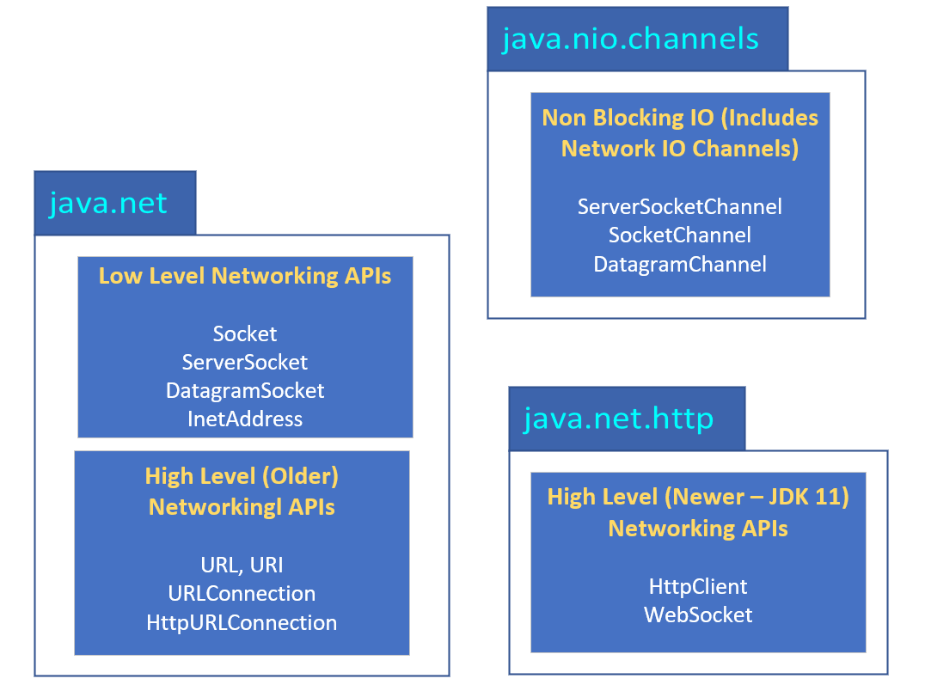
Networking packages
Java Networking types can be split roughly into two groups, low level APIs, which work with sockets and network addresses, and high level API types, that abstract connectivity, with the use of such types as URLs, Http Connections, and Http Clients.
In addition, the java.nio package offers an alternative communication mechanism, in the form of channels.
When using the low level API, you have to be more aware of networking concepts.
COMPLETE JAVA MASTERCLASS
Networking Terminology

Slide 17
Sockets
When using the low level networking API, you'll use sockets to establish connections, send requests, and receive responses.
A socket is one end point of the two-way connection.
The client will have a socket, and the server will also have a socket.
When you have multiple clients connecting to the same server, they'll use the same port, but each client will have its own socket.
You'll use the Socket class for the client socket, and the ServerSocket class for the server socket.
COMPLETE JAVA MASTERCLASS
Networking Terminology

Slide 18
Overview
Since we're talking about networking, we're going to have to write two applications to demonstrate how to do networking coding.
One application will be the server, and the other will be the client.
COMPLETE JAVA MASTERCLASS
Networking Terminology

